Slide 1
Massimo Puchinio
(Persona)
Made by: Kalem Sdao

Slide 2




Who is our Persona?
Name: Massimo Puchinio
Age: 27
Marital Status: Engaged
Education: Culinary School
Job: Sous Chef @ (Parlinis Bruschetta Home)
Location: Naples, Italy
Hobbies: Cooking, Fashion, Sailing, Football

Slide 3
Who really is Massimo? (Bio)
Massimo is a late twenties man who loves to cook. He gained this admiration from his late mother who always told him cooking was the escape from normality. He loves supporting local Italian restaurants and hopes to become a Head chef or even open his own restaurant some day.
Upon looking for new recipes and spices to try new meals with, He comes across our website, being SpiceLyfe.
His love for food and flavor draws him to the website, and the very infomercial look keeps him interactive as not being a very tech savvy customer, allows him to still understand the content and stay engaged.
On the next slide I have a picture of our Wireframe

Slide 4
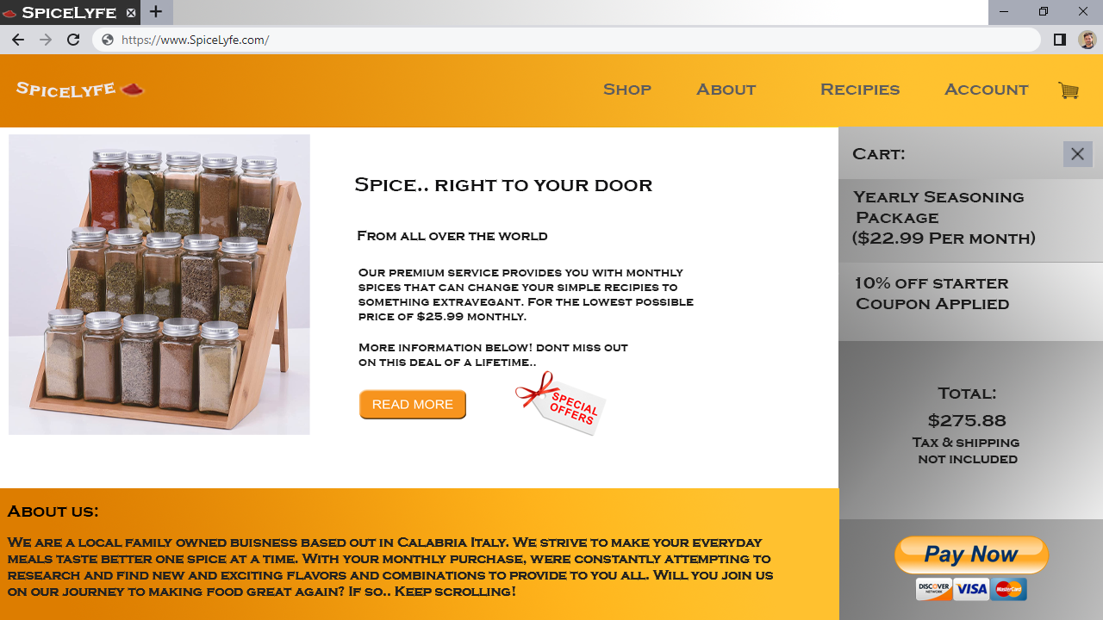
Our Website WireFrame

Slide 5
Why did this wireframe not only target Massimo but earn his purchase?
The first thing that caught his attention was the bright colour pallet and beautiful spice rack (As he is a innovative and aspiring chef)
Upon reading more, he learns that our company are Italian and family owned, and as stated in his bio he loves supporting local businesses.
When viewing the pricing, he is offered a 10% discount for new members and Is inclined to make his first purchase as “the offer goes away soon”
The site also had a very user friendly feel which allowed Massimo who is practicing his English to carefully read and navigate the website

Slide 6
Other users activity?
Younger users: Most will skip over our website as cooking isn't very appealing to younger audiences, however some may stick around and contemplate using our service.
Middle age users: Our most popular demographic. Cooking is slowly becoming a prominent part in these users days and they feel as though their meals are all tasting the same. Our company and website displays a quick and easy fix to these problems.
Elderly users: Some might be interested, however, most won't. They have been around long enough to know what they enjoy and most aren't willing to experiment at this age
Foodies: Most of our customers “foodies” are those who enjoy every last bit of their plate, and will do anything to make flavors last forever. This website is most appealing to them.
Experimental young adults: I personally believe young adults that are looking for change might also find our service and website good to look into, as the service offers something new.

